Slide 1

Exploratory Data Analysis
G2M Case Study
21-Sep-2022

Slide 2

Agenda
Executive Summary
Problem Statement
Approach
EDA
EDA Summary
Recommendations

Slide 3
Executive Summary
Background Information: Analysis for XYZ
Company, a private investing firm, takes a
look at possible cab companies for a future
investment.
Objective: Procure information from Pink
Cab and Yellow Cab for a Go-to-Market (G2M)
strategy.

Slide 4
Problem
Statement
& Approach
This analysis will provide insight for the
G2M strategy for investment based
on the data provided from Yellow Cab
and Pink Cab. Metrics include growth
of sales, transaction information,
and customer demographics.

Slide 5
Exploratory
Data
Analysis
Cab_Data.csv:
        Transaction ID
        Date of Travel
        Company
        City
        KM Travelled
        Price Charged
        Cost of Trip

Slide 6
Exploratory
Data
Analysis
Customer_ID.csv:
        Customer ID
        Gender
        Age
        Income (USD/Month)

Slide 7
Exploratory
Data
Analysis
Transaction_ID.csv:
        Transaction ID
        Customer ID
        Payment_Mode

Slide 8
Exploratory
Data
Analysis
Master File Containing:
        Cab_Data.csv
        Transaction_ID.csv
        Customer_ID.csv

Slide 9
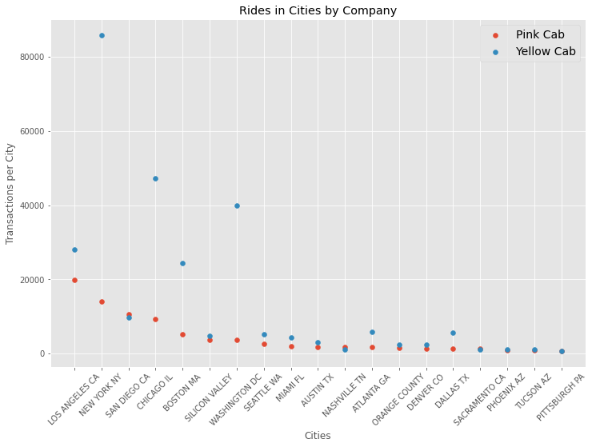
Exploratory Data Analysis
City | Transactions
New York, NY | 99885
Chicago, IL | 56625
Los Angeles, CA | 48033
Washington, DC | 43737
Boston, MA | 29692
San Diego, CA | 20488
Silicon Valley | 8519
Seattle, WA | 7997
Atlanta, GA | 7557
Dallas, TX | 7017
Miami, FL | 6454
Austin, TX | 4896
Orange County | 3982
Denver, CO | 3825
Nashville, TN | 3010
Sacramento, CA | 2367
Phoenix, AZ | 2064
Tucson, AZ | 1931
Pittsburgh, PA | 1313

Slide 10
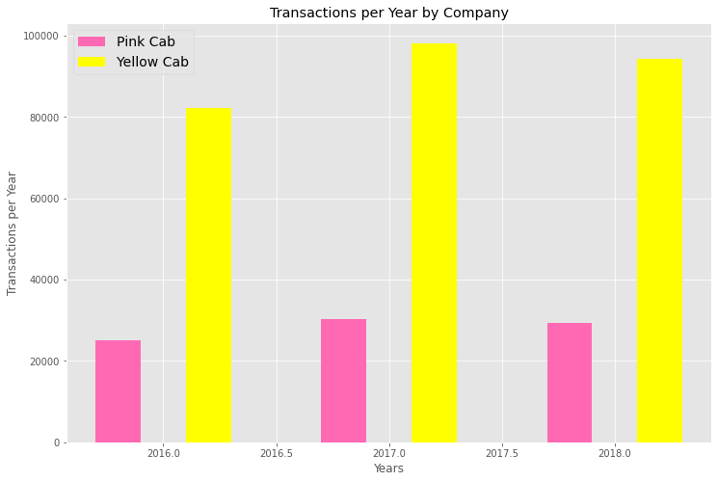
Exploratory Data Analysis

Slide 11
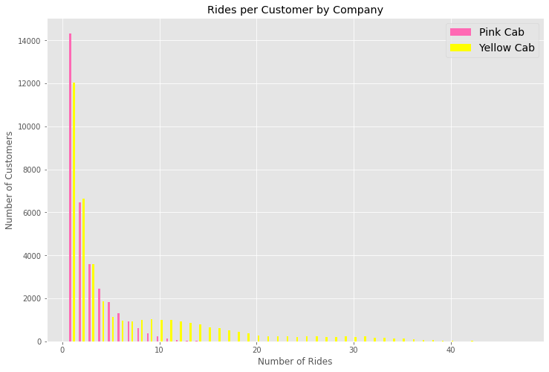
Exploratory Data Analysis

Slide 12
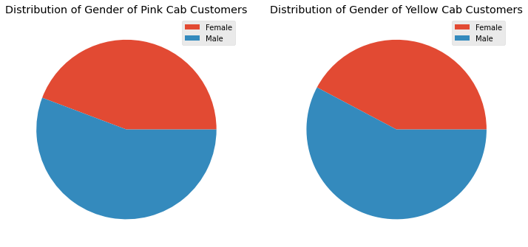
Exploratory Data Analysis

Slide 13
Exploratory Data Analysis
Pink Cab Company Age Distribution
Yellow Cab Company Age Distribution
Statistic | Value
Count | 84711
Mean | 35.322
Standard Deviation | 12.645
Minimum | 18
25% | 25
50% | 33
75% | 42
Maximum | 65
Statistic | Value
Count | 274681
Mean | 35.341
Standard Deviation | 12.579
Minimum | 18
25% | 25
50% | 33
75% | 42
Maximum | 65

Slide 14
Conclusions
&
Recommendations
During this time frame:
  Yellow Cab had more rides / transactions
  Yellow Cab showed more growth through increasing the number of transactions over time
  Yellow Cab had greater customer retention
  The gender distribution was similar for both companies
  The age distribution was similar for both companies
Recommendation:
Based on the conclusions above, Yellow Cab appears to show greater potential for investment and growth, if they continue on this path.

Slide 15
Thank You

